Slide 1
Appointment Scheduling Paltform

Slide 2









Problem Statement
Autonomous Trust & Verification
Manually Intensive Onboarding
Problem
Context
Solution
Approach
vs
Rigid Reservation Systems
RAG AI Conversational Assistant
Proper roles Management
High Administrative Overhead

Slide 3
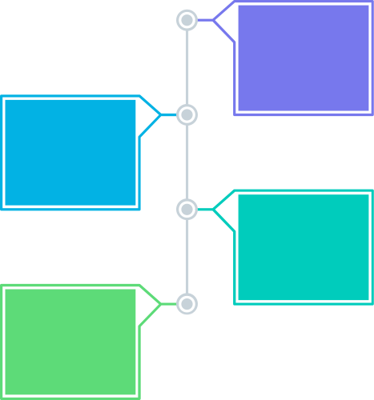





Platform Admin
End Customer
Core Capabilities:
Manage platform users
Verify providers & organizations
Analyze operational workflows
Oversee global metrics
Core Capabilities:
Book real-time appointments
Configure available personal slots
Reschedule / cancel flexibly
Submit provider reviews
Multi - Tenant User Ecosystem
02
04
Service Provider
Organization
Core Capabilities:
Define slot calendars
Reschedule/adjust plans
Analyze business performance
Join/leave organizations
Core Capabilities:
Approve onboarded providers
Manage corporate providers
Analyze group performance
Handle aggregated payouts
01
03

Slide 4
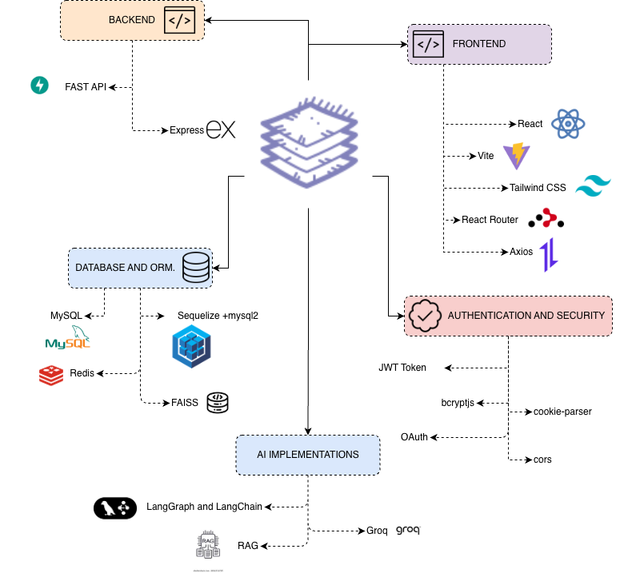
Tech - Stack

Slide 5
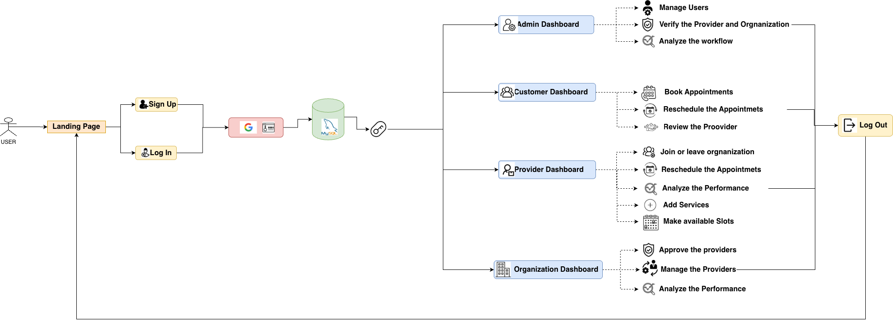
Project Workflow

Slide 6









Provider Onboarding and multi stage approval pipeline
01
Sign up and Profile
Provider enters registration data. Choice of independent practitioner or associating with an active corporate organization tenant.
02
Doc Upload
User uploads legal identity (ID/passport) and professional licenses or certifications (PDF/images) directly to secure MySQL database.
03
Automated Checks
Groq + LangGraph processes documents. Extracts credentials, checks expiration dates, and queries official public registries instantly.
04
Final Approval
Organization Manager or Platform Admin receives AI verification insights, reviewing flagged alerts before granting final active state.
05
Go Live
Provider's calendar is unlocked. They configure slots, service types, and become queryable by both web users and the AI Assistant.

Slide 7
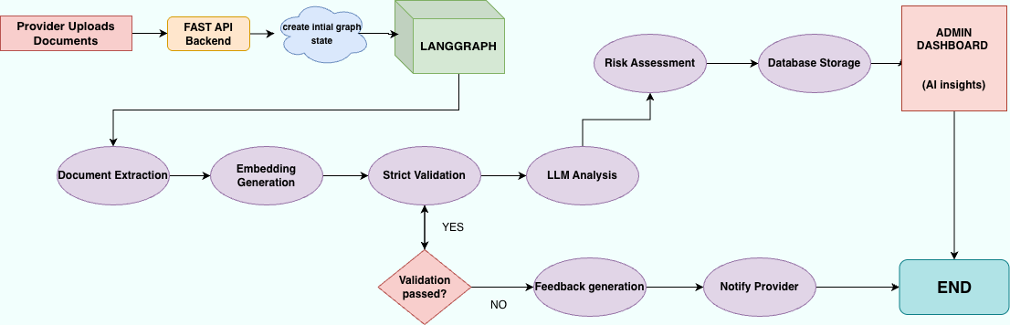
LangGraph Architecture

Slide 8
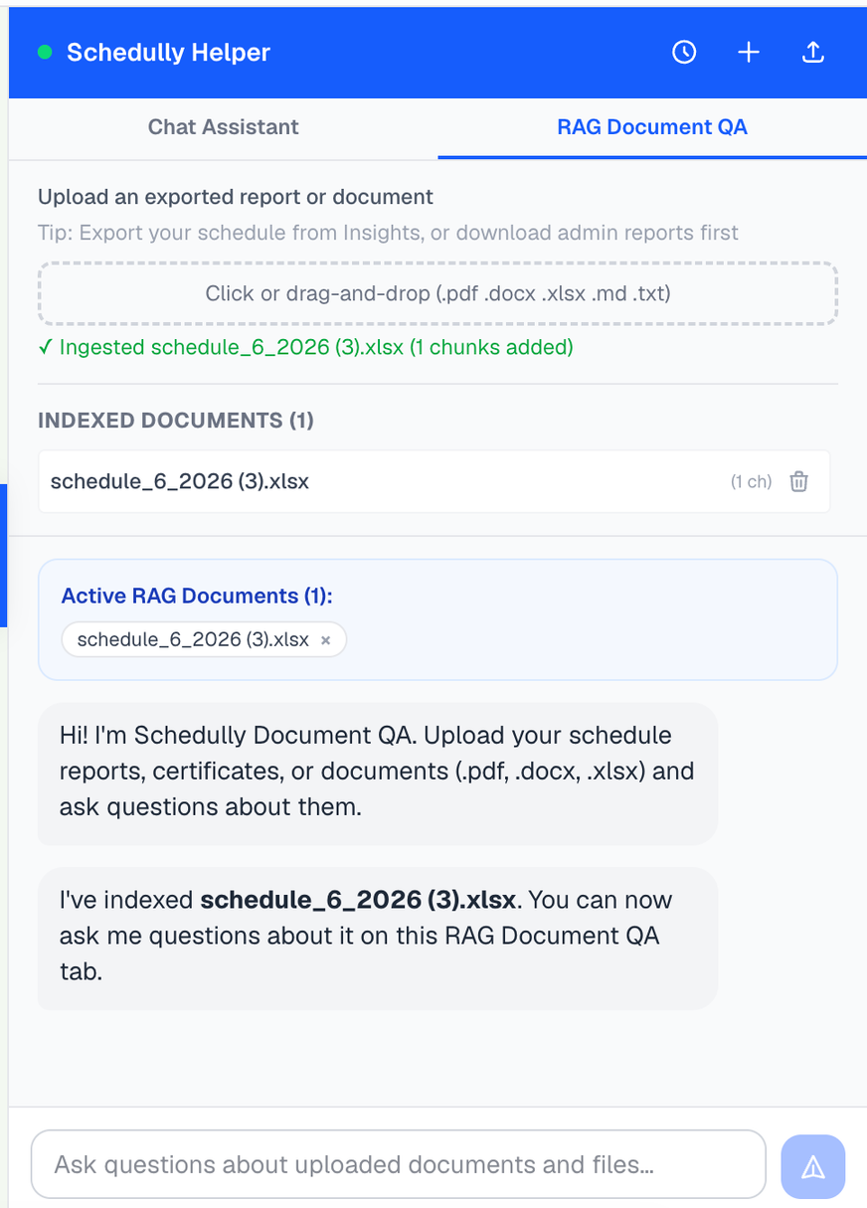




RAG Based AI Analysis And Insights
01
Direct NLP Intent classification
02
Dynamic Vector Search
API Augmented Real time Lookups
03
04
Transaction Executin and State Updates

Slide 9
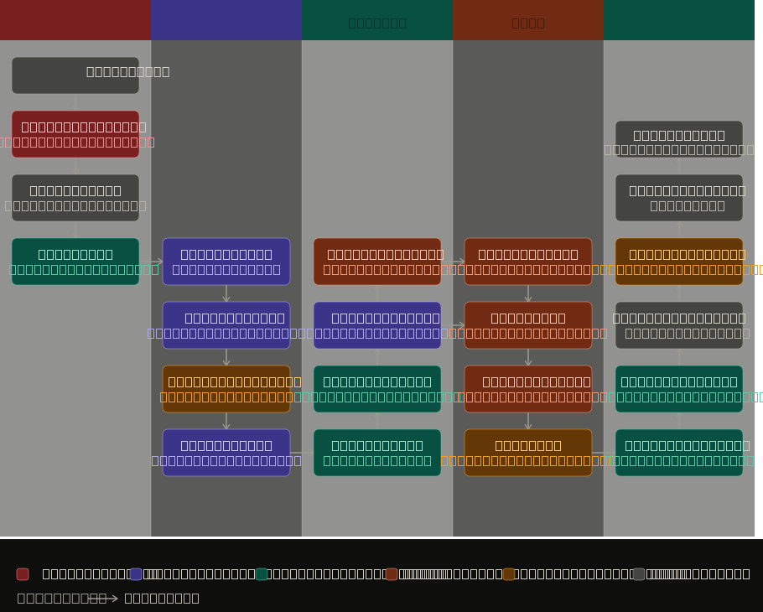
RAG and Chatbot architecture
1. Security gates everything upstream — injection guard + convo check run before any business logic touches the message.
2. Three independent cache layers — Planning (TTL 300s), Routing (slot-cache + embeddings), and Generate (msg + context hash) each tuned to different staleness budgets.
3. Routing resolves intent; Data fetches — clean lane separation means the classifier can be retrained without touching the API layer.
4. Data lane sanitises in-flight — PII scrub and payload prune (15 appts, 5 reviews cap) happen before data ever reaches the generator.
5. Amber nodes are the only fallback/warning signals — Weak watermark and Verifier (score ≥ 0.5) are the only two places the system can flag degraded confidence, making failure modes explicit and auditable.

Slide 10
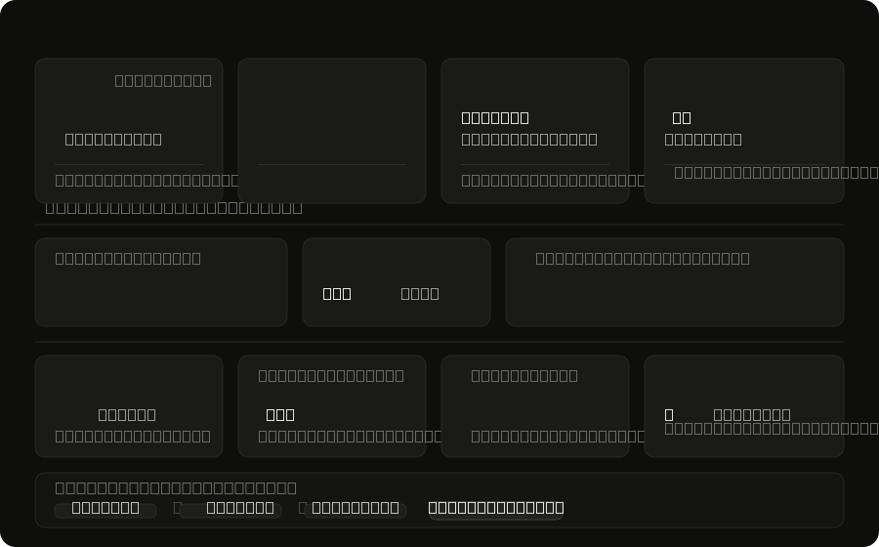

Slide 11






Acheivements
Role Based Access
Role based manangement for Admin, Customer , Provider and Organization
RAG Based Chat Support
Provide accurate, context-aware responses using organization-specific knowledge and documents.
Automated Book, Cancel And Review
Allows customers to book,cancel and review appointments through natural language conversations with the AI chatbot.
Rule based Engine
Implements configurable business rules and customer-side action policies to analyze and enforce validation criteria consistently.
Automated Document Verifcation
Automate document validation, fraud detection, and compliance checks . Reduces manual effort, and accelerates onboarding decisions.

Slide 12







Future Scope
Dynamic Buffer Pricing
Predictive Scheduling Matching
Machine-learning powered prediction models that automatically adjust scheduling slot price rates during high-demand periods.
Analyzing historical booking trends to proactively suggest and lock premium slots for high-fidelity recurring customers.
Multi Language Support
Enable customers to communicate with the AI booking assistant in their preferred language through real-time multilingual conversations.
Interactive Voice Booking
Extending the RAG conversational assistant into voice telephony (VAPI/Twilio), facilitating seamless hands-free audio reservations.
Dockerized Deployment
Consistent environments and simplified deployment.Deploy using AWS, GCP, or Azure for high availability and scalability.

Slide 13


Challenges Faced and Solutions
From Issues
To Improvements
Calendar Sync Never Fired
Real-time WebSocket
Users were able to book appointments successfully, but it wasn’t being shown in the calendar tab.
01
Push a real-time update webSocket so the calendar updates immediately.
Unnecessary Rerendering
Optimisation Techniques
The applicatrion was re-rendering unnecessarity whenever we used to trigger events.
02
Debounce high-frequency events (typing, mousemove, resize) and throttle handlers.
DB Load
Redis implementation
There are multiple DB in the application and every event was expecting DB actions directly which was incresing load on the DB.
03
Implemented Redis, where the request first goes to Redis before hitting the backend.
Token Constraints
Graphify and Skills
Almost exhasuted every email id that I had for tokens.
04
Added skills.md to the project so the AI knows exactly what we are expecting it to do, used graphify to control the number of token used.

Slide 14
Challenges Faced - Anwesha
From Issues
To Improvements
Unstructured Prompts
Role-Based and Phased Development
Initial prompts produced inconsistent architectures and UI designs.
01
Introduced role-based prompting and divided development into smaller implementation phases.
Hallucinations & Incorrect Assumptions
Continuous Validation and Model Selection
Some outputs looked correct but followed incorrect reasoning paths or assumptions.
02
Cross-verified outputs, refined prompts, and used different models based on task complexity.
Context and Token Limitations
Repository Aware Context Management
Large codebase caused missing context and incomplete solutions.
03
Adopted Graphify, architecture summaries, and phased context loading.
LangGraph Workflow Complexity
Planning Implementation Separation
AI struggled with workflow orchestration, routing logic, and state management.
04
Used Haiku for workflow planning and Sonnet for implementation.

Slide 15
Challenges I Faced and Solutions-Nikhil
From Issues
To Improvements
lack of business logic building sense
created a markdown with business logic rules
AI agents could not pick up on the underlying business logic when shifting between threads and joining the codebase development
took the initial document provided to us and supplied it to claude and detailed business logic ,used this markdown in all future conversations making agents refer to it
01
context window limitations
implemented graphify
due to a single thread becoming too long to retain all context about codebase token consumption exponentially increased with each prompt
installed a library called graphify which converted the entire codebase into a graph structure with connected nodes,instead of continuing in old thread with fear of losing context,referenced output of graphify to get summarized crisp codebase context
02
verbose response and role mismatch
system prompt ,agentic priming and caveman mode
any new agent which worked on my codebase gave verbose wordy responses(gemini models in particular) and did not activate the latent space of a developer when coding
03
made effective use of system prompts,used claude for planning and prompt creation(gave it a role of a prompt architect),then gave the prompts to agentic tools with caveman mode and agentic priming configured
Manual testing and human errors
pinchtab and playwright based testing
when testing the codebase for errors it became difficult to remember and check each flow in detail
04
made use of pinchtab to explore each screen of the application and recorded each possibel flow to write testcases,then used playwright to automate and check those test cases
chaotic responses by chat interface built
controlling model parameters for api call such as max tokens and temperature
the responses given by the chatbot which we built as we ll as the rag was not referencing appropriate context directly for simple queries
05
configured the temperature setting to 0.2 for standard responses and also set max tokens to save on the cost of free limit api key used
Long prompts mentioning standard technical practises
skill file usage
when switching between chat threads or even starting a new one ,standard practises followed in any application such as maintaining security,seperating controllers and servicces needed to be mentioned
made use of the make-it-right skill file ,speckit and andrej karpathy skill file ,wrote a custom prompt to make use of the make-it-right skill to refactor an existing codebase since the skill is mainly written to build something from scratch we use it to treat our existing codebase as source of truth and modify that
06

Slide 16
AI Tools Used and comparison
1)Antigravity:Works well only issue is the token limitation decreasing within a single threa upon switching accounts
2)Codex:Very limited tokens but highly accurate for specifically backend development(able to discern business logic and design schemas and services which can accomodate future enhancements very well
3)cursor:Good for specific feature fixes across frontend and backend
4)Copilot:Not a good tool context window gets bloated very fast and very frequent hallucinations and once context reaches which is very often it says it summarises context but then hallucinates
5)Blackbox AI:Went into a loop upon prompting to fix a feature related to google calendar integration and did not even suggest to use google calendar api
6)Trae:Went into a loop and did not follow instructions to get codebase context from graphify
7)Kilo code:Good tool provided that we use the correct model but takes lot of time for responses,deploys subagents and divides a task down into small achievable milestones,good for bug fixes and feature developement on an existing codebase
8)Kiro:Specifically used it for making the base of the chatbot ,which covered frontend and backend
9)Claude:mainly the claude-sonnet model which was good balance between token usage and

Slide 17
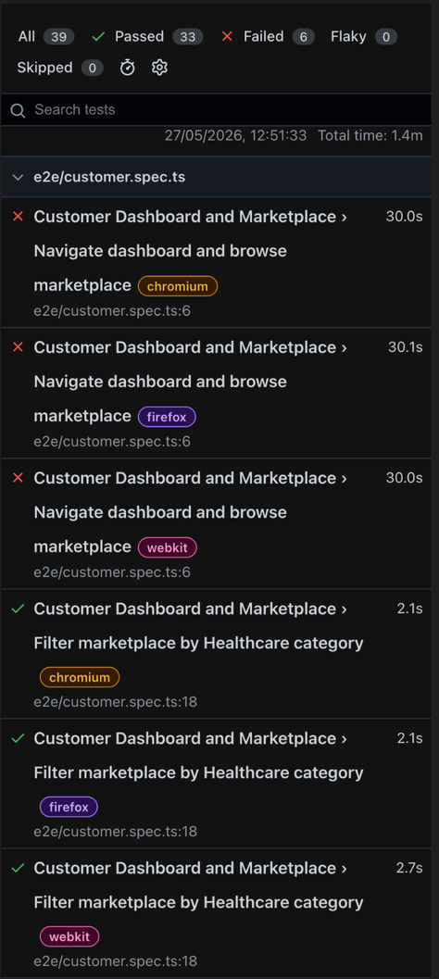
Automated testing and flow discovery

